Slide 1



Praktična delavnica Docker & Kubernetes
November 2022
SSID: FE-Guest
USR: idockerinkubernetes
PASS: 9335
www.ict-academy.eu

Slide 2
AVTORSKE PRAVICE GRADIVA
Vsa gradiva usposabljanja Docker & Kubernetes, september 2020 (predavanja, demonstracije, vaje), so last Univerze v Ljubljani, Fakultete za elektrotehniko (UL FE).
Uporaba je dovoljena izključno v okviru usposabljanja.
Noben del gradiva ne sme biti reproduciran, shranjen ali prepisan v katerikoli obliki oziroma na katerikoli način (elektronsko, mehansko, s fotokopiranjem, snemanjem) brez predhodnega pisnega dovoljenja.
Vse pravice pridržane. © september 2020, UL FE.

Slide 3
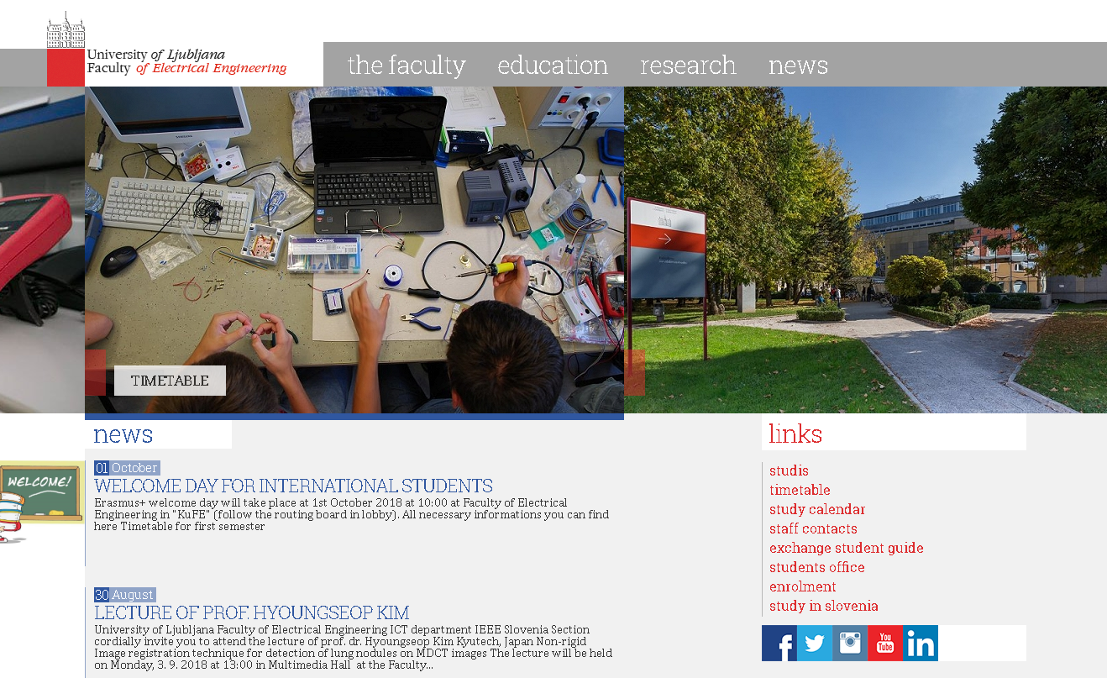
UL Fakulteta za elektrotehniko
2.200+ študentov
300+ raziskovalcev in akademskega osebja
50 % sredstev pridobljenih na trgu

Slide 4


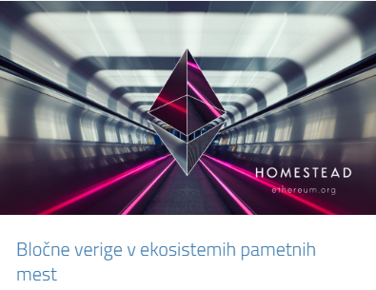
Laboratorij za telekomunikacije Laboratorij za multimedijo

Slide 5
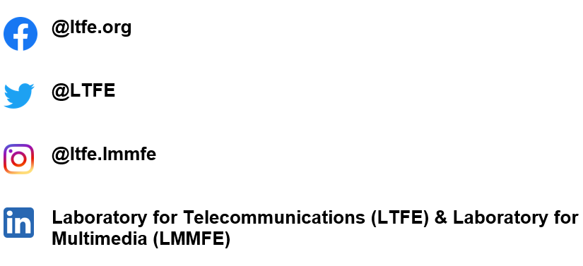
Najdete nas tudi na:

Slide 6
Področja uporabe IKT/IoT
2010
Networks, Telecommunications, ICT
2020
eHealth and Wellbeing
Industry 4.0
Public safety
Innovations
...
ICT
...
ICT
ICT
ICT
Transport
Education and Training
Energy
Turism
ICT
ICT
ICT
ICT

Slide 7







Aktivnosti (1)
Usposabljanja za podjetja in organizacije
IKT-akademija, IoT-akademija, Digitalna akademija
Multimedijsko podprto učenje, E-Cho
Prototipiranje, Makerlab/Openlab/FabLab
Rešitve IKT/IoT za različna področja
AR/VR/360º za športne dogodke in dostopnost
Odprto inoviranje: Pametno ogledalo, Gnezdo, SmartFroc
Digitalno inovacijsko stičišče
Sodelovanje in povezovanje s študenti

Slide 8







Aktivnosti (2)
Pilotne in demonstracijske rešitve
Rešitve za pametna mesta in vasi
112 aplikacije (4G/5G/VR)
IoT in omrežja za ceste
Blockchain IoT in PoE
Kibernetska varnost; honeypoti ter analitika vdorov
Razvojni projekti
Signalizacije in kontrolna ravnina
Smartgrid komunikacije in IoT
Testiranje omrežij
Vsebine AR/VR, 360º

Slide 9
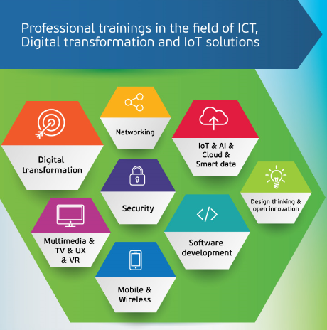

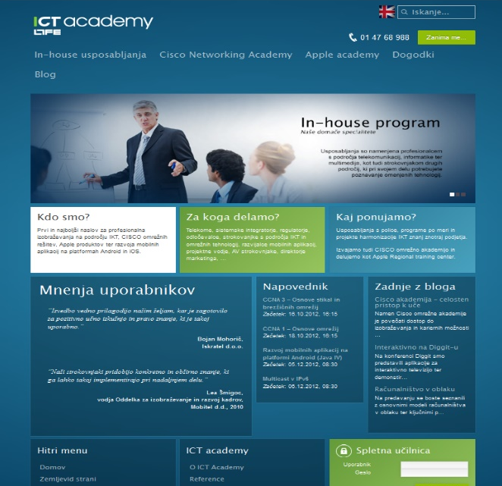
www.ict-academy.eu

Slide 10

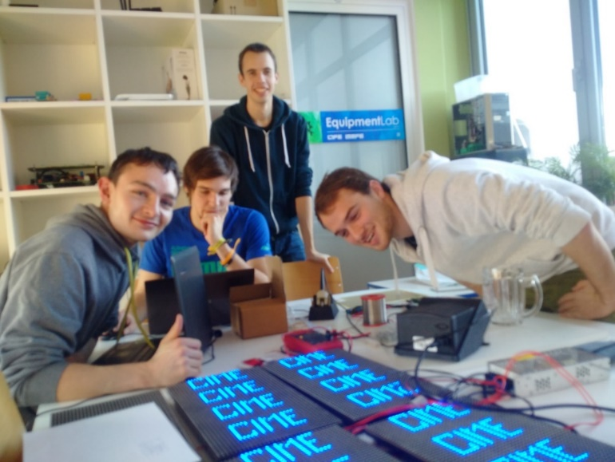
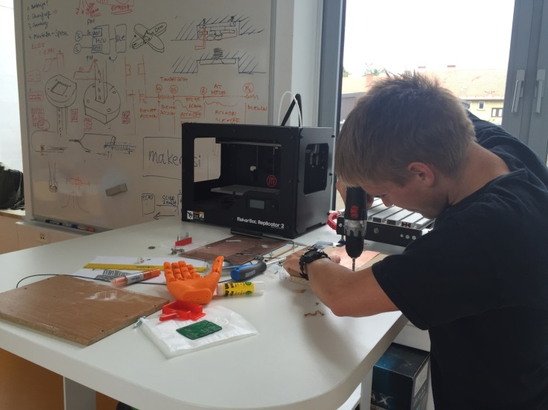
Prototipiranje, MakerLab
Poudarek na IoT
Razvoj, inovacije
Learning by doing

Slide 11
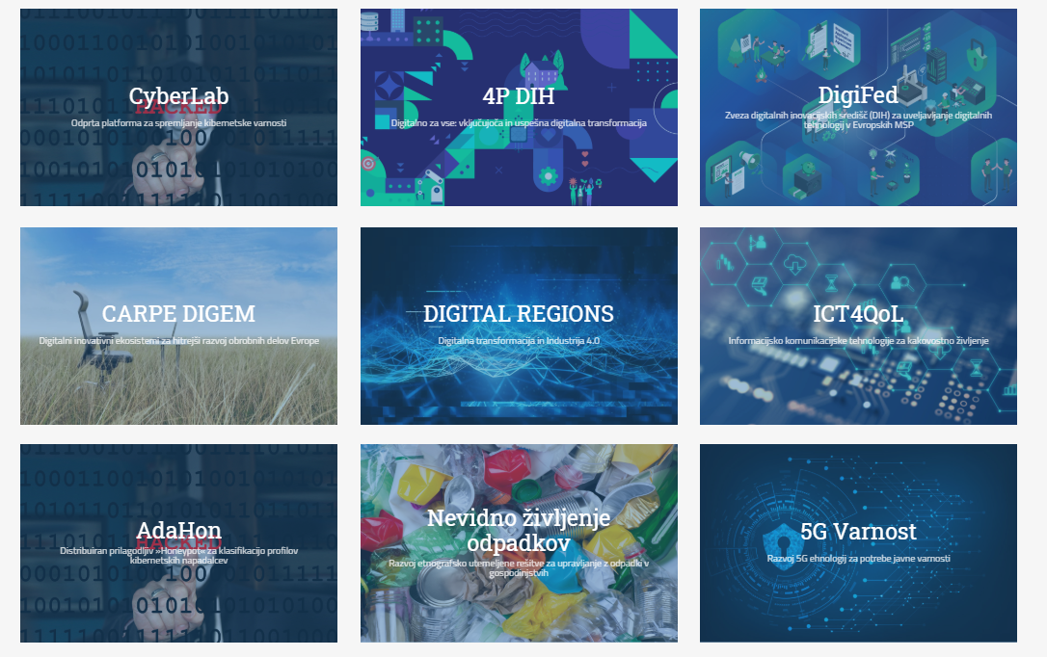
Pilotne in demonstracijske rešitve, R&D

Slide 12
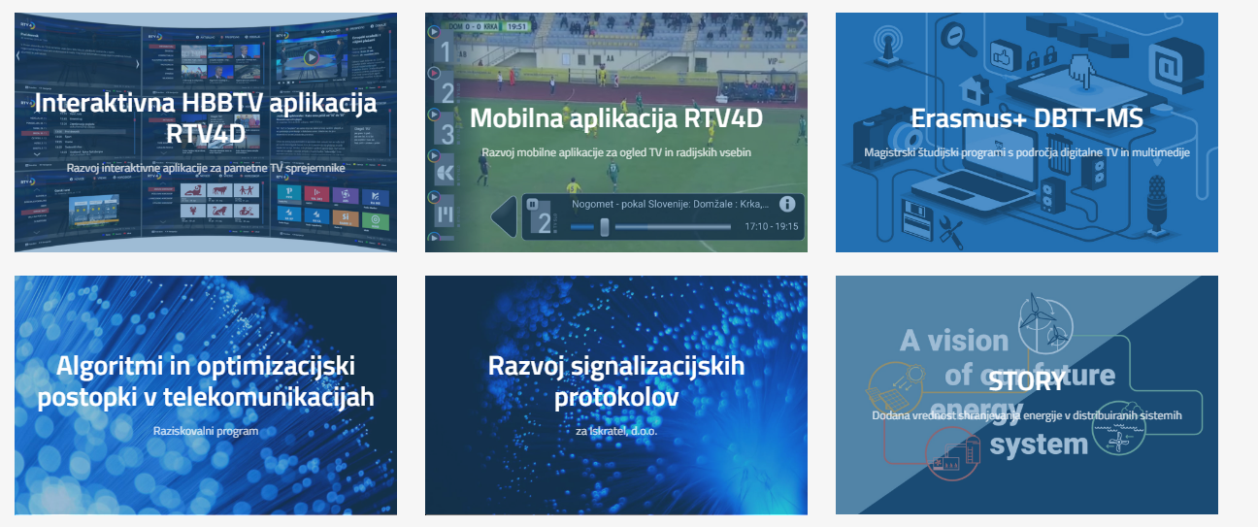

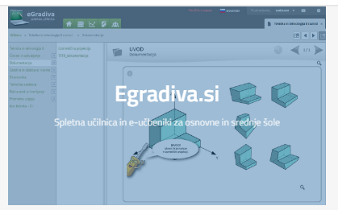
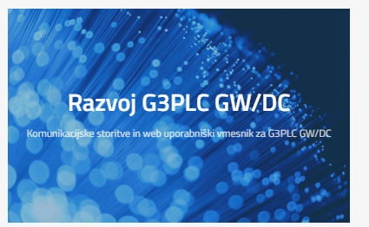
Razvojni projekti

Slide 13
Predpriprava
Predpripravljena virtualka
Razdelimo uporabniška imena in gesla
Prenesemo gradiva iz Git-a:
git clone https://github.com/icta-tecaji/docker-k8s-public.git
Namestimo VS Code
https://code.visualstudio.com/

Slide 14
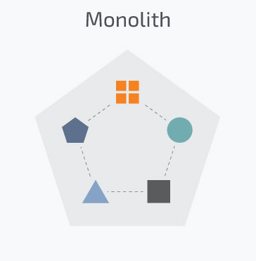
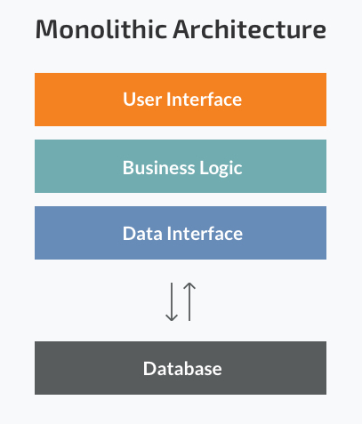
Traditional applications
Monolithic application
Years ago, most software applications were big monoliths
Built as a single and indivisible unit
Still widespread today
Challenges
Handling a huge code base
Adopting a new technology
Scaling
Lack of modularity
Deployment
Implementing new changes -> slow (entire application has to be rewritten)
Source: Microservices vs Monolith: which architecture is the best choice for your business? https://www.n-ix.com/microservices-vs-monolith-which-architecture-best-choice-your-business/

Slide 15
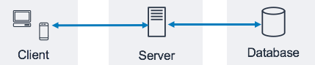
Client-side user interface, a server side-application, and a database.
Strengths
Less cross-cutting concerns (logging, handling, caching, and performance monitoring)
Little configuration it required
Easier debugging and testing
Simple to deploy (just one file or directory)
Simple to develop (knowledge – standard way of development)
MonolithFirst
Source: Three-Tier Architecture Overview - https://docs.aws.amazon.com/whitepapers/latest/serverless-multi-tier-architectures-api-gateway-lambda/three-tier-architecture-overview.html
Notes:
Strengths of the Monolithic Architecture
- Less cross-cutting concerns. Cross-cutting concerns are the concerns that affect the whole application such as logging, handling, caching, and performance monitoring. In a monolithic application, this area of functionality concerns only one application so it is easier to handle it.
- Easier debugging and testing. In contrast to the microservices architecture, monolithic applications are much easier to debug and test. Since a monolithic app is a single indivisible unit, you can run end-to-end testing much faster.
- Simple to deploy. Another advantage associated with the simplicity of monolithic apps is easier deployment. When it comes to monolithic applications, you do not have to handle many deployments – just one file or directory.
- Simple to develop. As long as the monolithic approach is a standard way of building applications, any engineering team has the right knowledge and capabilities to develop a monolithic application.

Slide 16
Scaling monolithic apps
Running a monolithic application usually requires a small number of powerful servers that can provide enough resources for running the application.
To deal with increasing loads on the system:
vertically scale the servers (also known as scaling up) -> adding more CPUs, memory, and other server components
usually doesn’t require any changes to the app
gets expensive relatively quickly
in practice always has an upper limit
scale the whole system horizontally (scaling out) -> setting up additional servers and running multiple copies of an application
relatively cheap hardware-wise
require big changes in the application code (sometimes impossible)

Slide 17
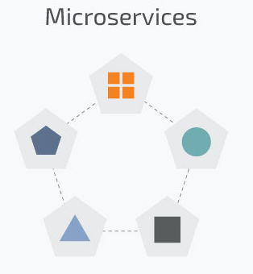
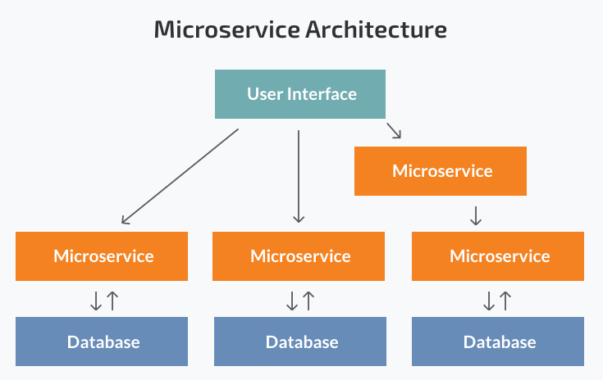
Microservices
Today, these big monolithic legacy applications are slowly being broken down into smaller, independently running components called microservices.
Source: Microservices vs Monolith: which architecture is the best choice for your business? https://www.n-ix.com/microservices-vs-monolith-which-architecture-best-choice-your-business/

Slide 18
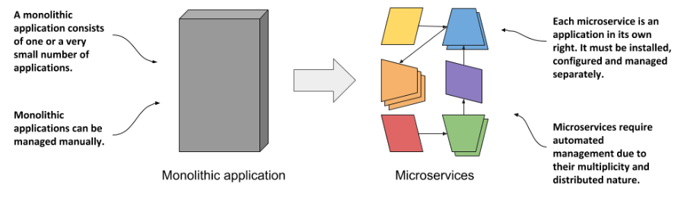
The monoliths were divided into dozens, sometimes hundreds, of separate processes.
This allowed organizations to divide their development departments into smaller teams.

Slide 19
These units carry out every application process as a separate service.
So all the services have their own logic and the database.
Components communicate with each other through defined methods called APIs.
Strengths:
Independent components
Easier understanding
Better scalability
Flexibility in choosing the technology
The higher level of agility
Weaknesses:
Extra complexity
System distribution
Cross-cutting concerns (configuration, logging, metrics, health checks)
Testing

Slide 20

Intro To Docker

Slide 21
Docker overview
Docker is an open platform for developing, shipping, and running applications.
Docker is a platform for running applications in lightweight units called containers.
Docker enables you to separate your applications from your infrastructure so you can deliver software quickly
Reduce the delay between writing code and running it in production
People’s number one “most wanted” technology

Slide 22
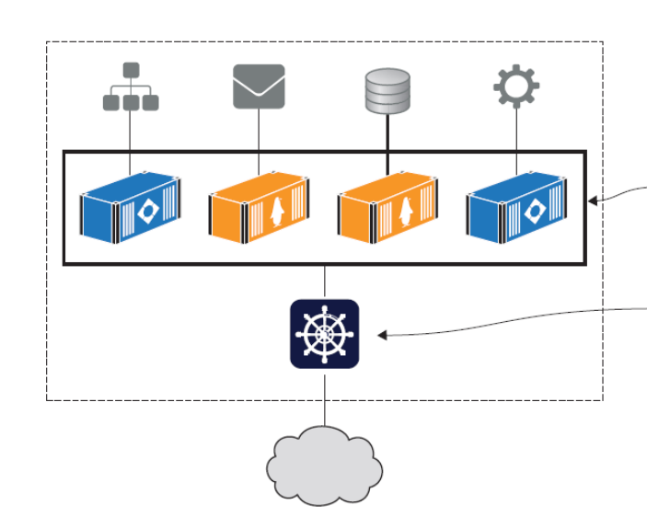
Why are containers and Docker so important?
Migrating apps to the cloud
Modernizing legacy apps
Building new cloud-native apps
Technical innovation: Serverless and more
Docker provides an abstraction
Protecting your computer
Improving portability
Getting organized
Source: Learn Docker in a Month of Lunches, ELTON STONEMAN

Slide 23
Installing Docker
Docker Desktop - Docker Desktop is an easy-to-install application for your Mac or Windows environment that enables you to build and share containerized applications and microservices.
Docker Engine - Docker Engine is an open source containerization technology for building and containerizing your applications. Docker Engine acts as a client-server application with:
Install Docker Engine on Ubuntu
Post-installation steps for Linux
[Optional] Manage Docker as a non-root user -> Security risks!
Configure Docker to start on boot
Verifying your Docker setup: docker version

Slide 24
Running Hello World in a container
And Docker images can be packaged to run on any computer that supports Docker, which makes the app completely portable — portability is one of Docker’s key benefits.
Example: Running multiple NGINX instances
About Docker Company

Slide 25
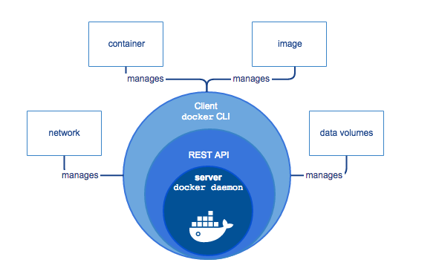
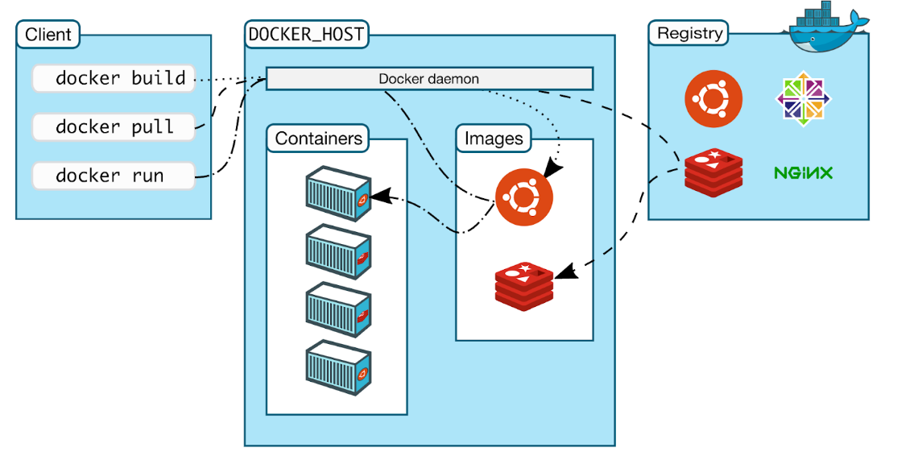
Docker Architecture
Docker is written in the Go programming language and takes advantage of several features of the Linux kernel to deliver its functionality.
Uses a technology called namespaces to provide the isolated workspace called the container.
Docker uses a client-server architecture.
Source: https://docs.docker.com/get-started/overview/

Slide 26
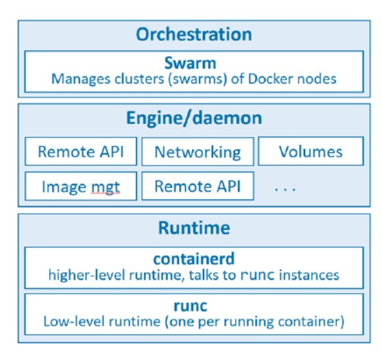
The runtime operates at the lowest level and is responsible for starting and stopping containers:
The low-level runtime is called runc
The higher-level runtime is called containerd
The Docker daemon (dockerd) sits above containerd and performs higher-level tasks
Docker also has native support for managing clusters of nodes running Docker.
Source: Docker Deep Dive, Nigel Poulton

Slide 27
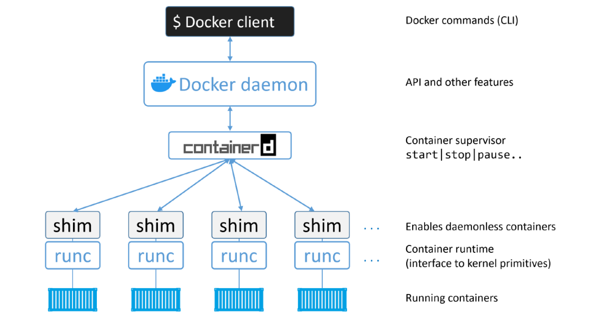
Source: Docker Deep Dive, Nigel Poulton

Slide 28
Containers

Slide 29
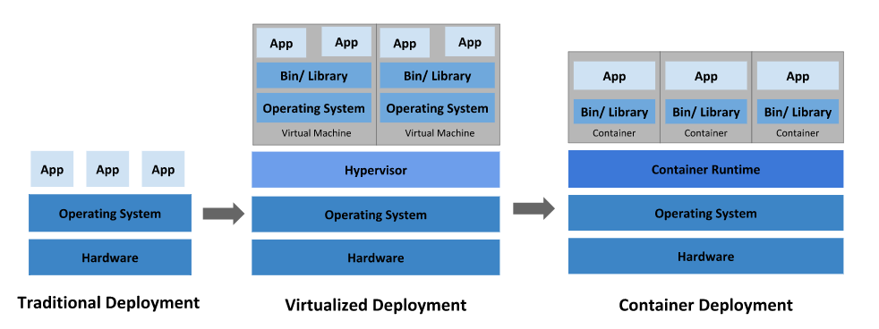
Containers History
Virtual Machines
Linux containers
Source: https://kubernetes.io/docs/concepts/overview/what-is-kubernetes/
Notes:
Motivacija:
Hardware je vedno cenejši in močnejši -> vedno bolj zahtevne aplikacije
Neizkoriščene zmogljivosti
Prostor v strežniških omarah je drag
Varovanje okolja
Zamudne in drage upravne naloge
Monitoring strojne opreme
Menjava pokvarjene opreme brez prekinitve delovanja sistema
Inštalacija in nadgradnje strežnikov so zahtevne
Backup

Slide 30
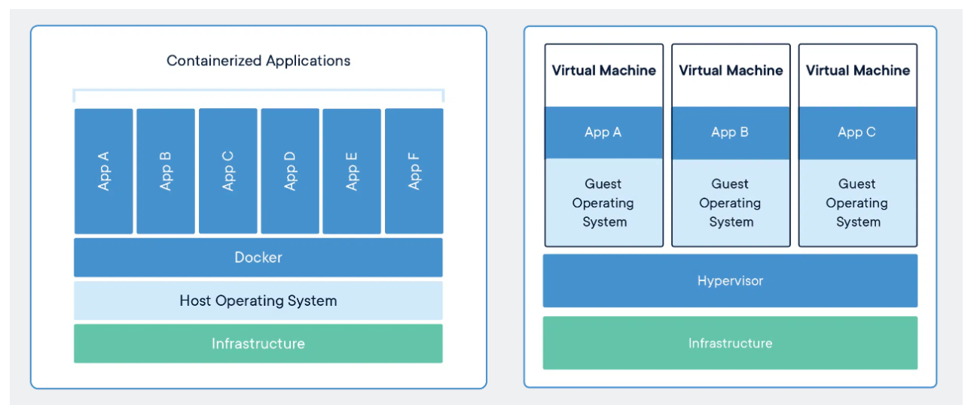
Containers vs Virtual Machines
Source: https://www.docker.com/resources/what-container/

Slide 31
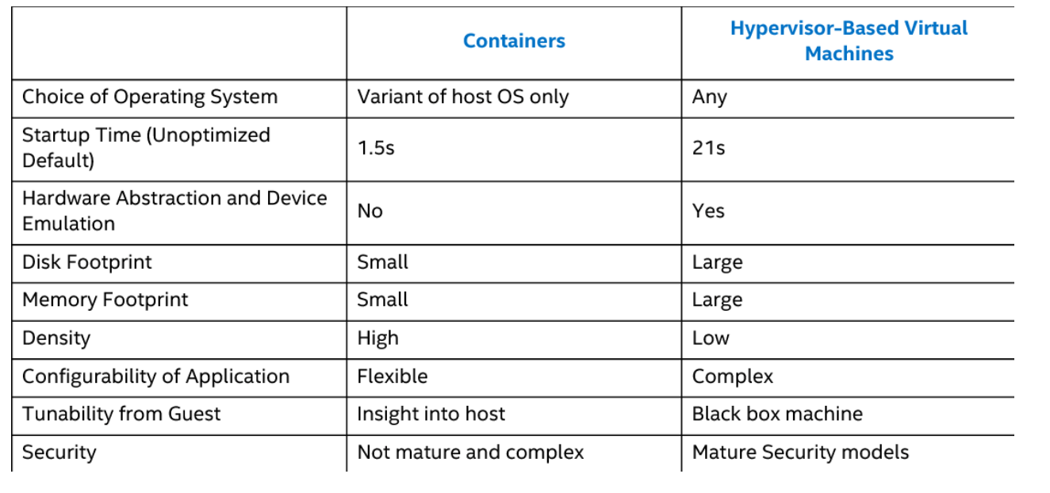

Slide 32
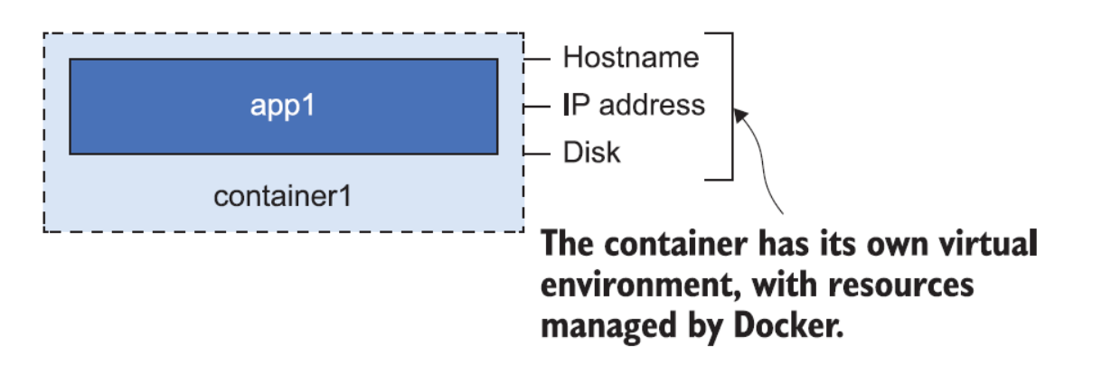
What is a container?
A Docker container is the same idea as a physical container — think of it like a box with an application in it
It has its own machine name and IP address, and it also has its own disk drive
The application inside the box can’t see anything outside the box
All containers share the CPU and memory of the computer, and they all share the computer’s operating system
Source: Learn Docker in a Month of Lunches, ELTON STONEMAN

Slide 33
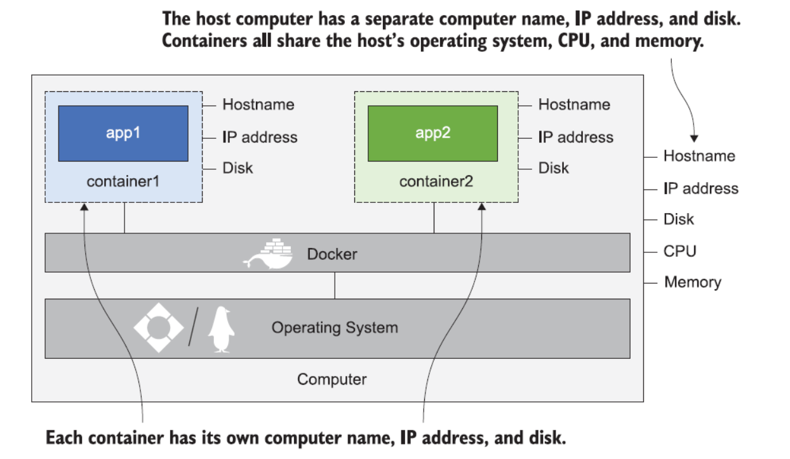
Source: Learn Docker in a Month of Lunches, ELTON STONEMAN

Slide 34
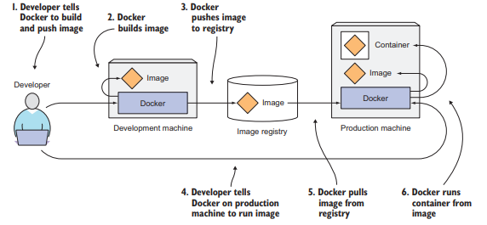
Starting a simple container
Web server example
Exploring the container filesystem and the container lifecycle
Stopping containers gracefully
Source: Marko Luksa - Kubernetes in Action-Manning Publications (2018)

Slide 35
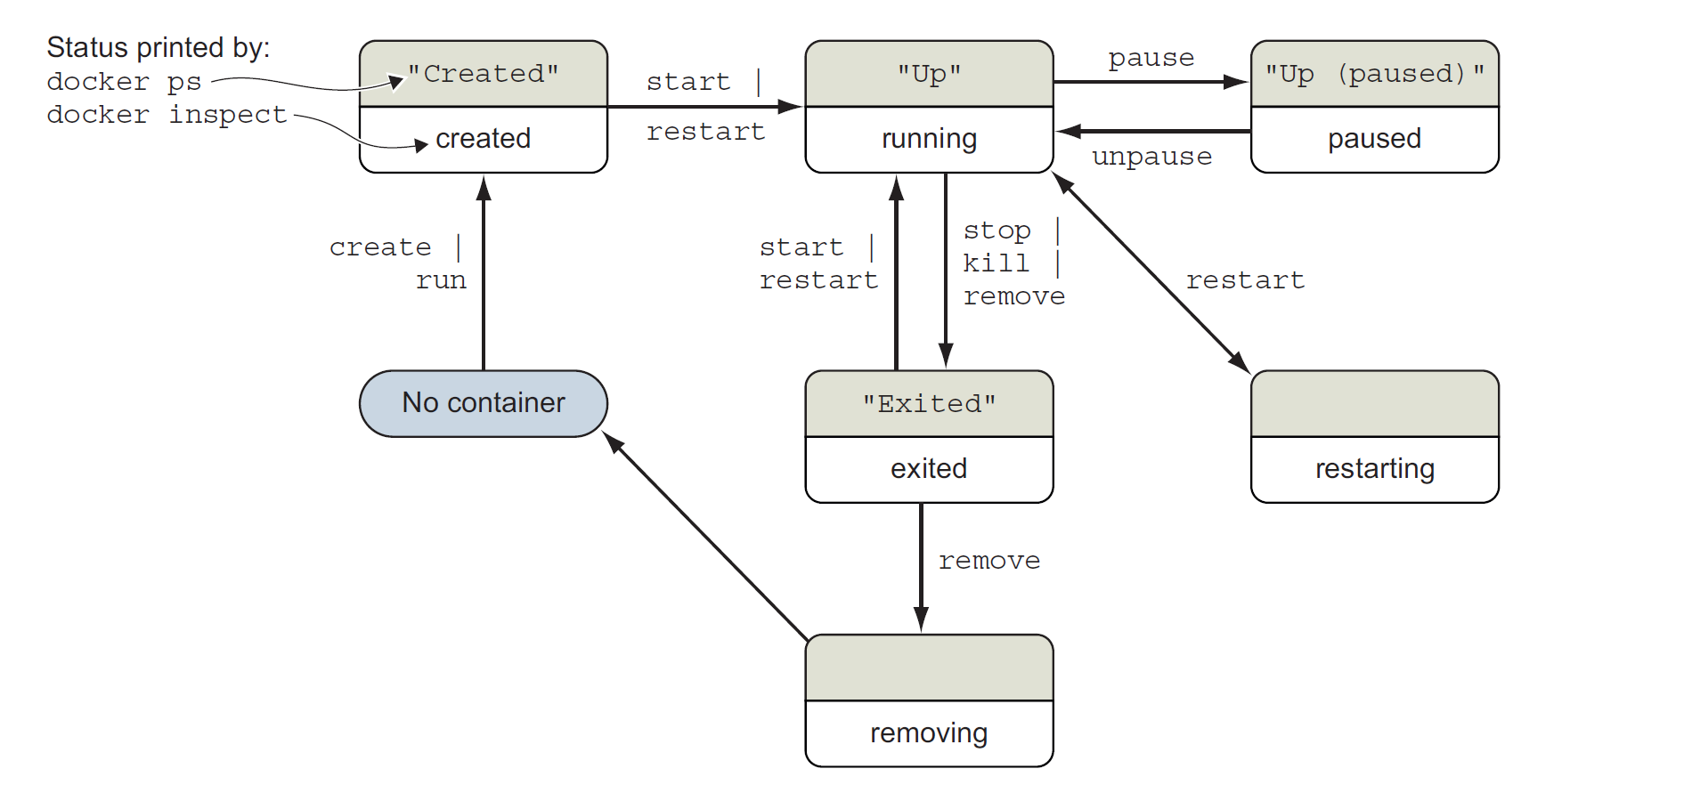

Slide 36
Docker Images

Slide 37
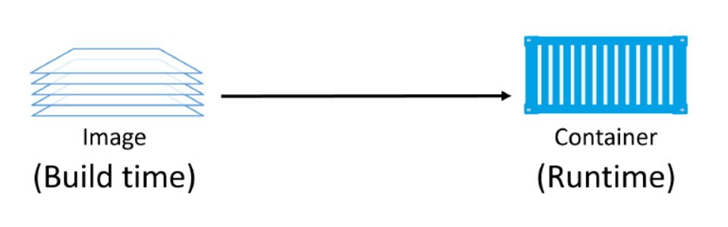
About Docker Images
A Docker image is a unit of packaging that contains everything required for an application to run.
application code
application dependencies
OS constructs.
You get Docker images by pulling them from an image registry.
Images are made up of multiple layers, images tend to be small
Source: Docker Deep Dive, Nigel Poulton

Slide 38
Images are usually small
The whole purpose of a container is to run a single application or service.
This results in small images stripped of all non-essential parts.
Image also don’t contain a kernel — all containers running on a Docker host share access to the host’s kernel.
Pulling images
A cleanly installed Docker host has no images in its local repository.
The process of getting images onto a Docker host is called pulling.

Slide 39
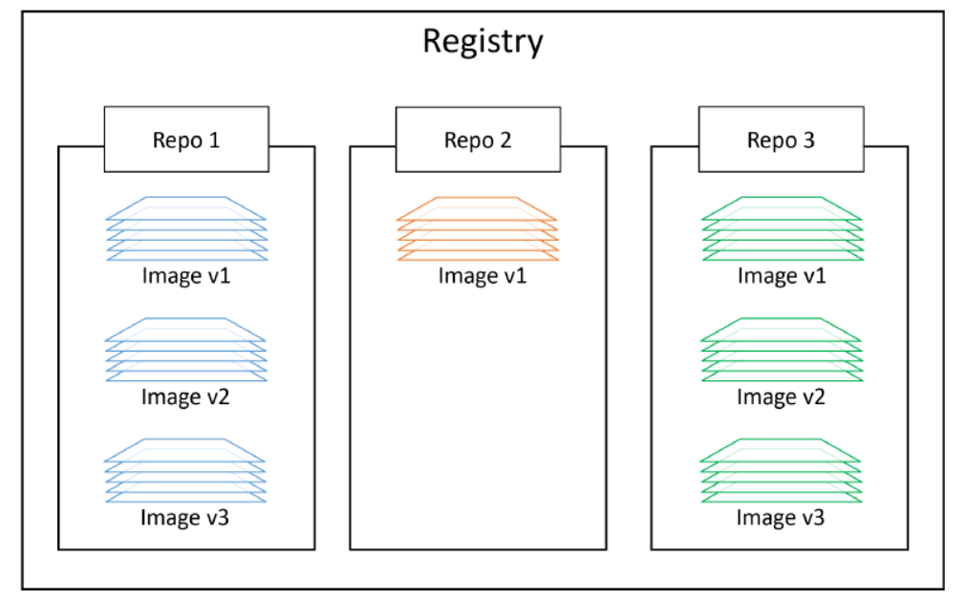
Image registries
We store images in centralised places called image registries.
The most common registry is Docker Hub.
Image registries contain one or more image repositories. In turn, image repositories contain one or more images.
Source: Docker Deep Dive, Nigel Poulton

Slide 40
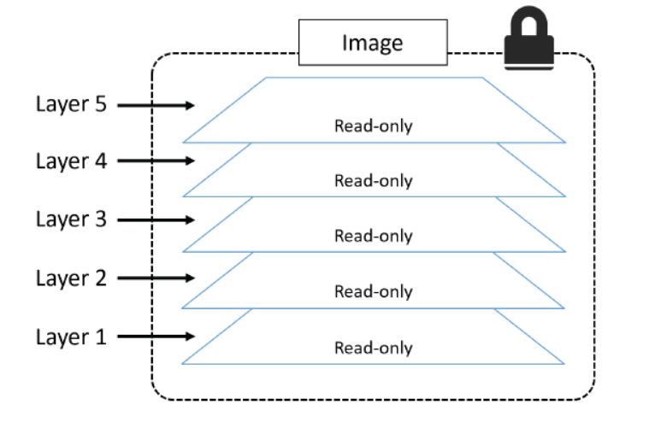
Images and layers
A Docker image is just a bunch of loosely-connected read-only layers, with each layer comprising one or more files.
Source: Docker Deep Dive, Nigel Poulton

Slide 41
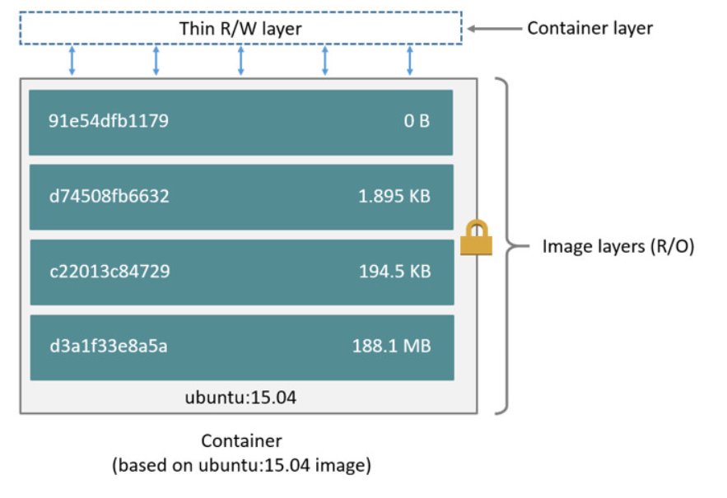
Source: Docker Deep Dive, Nigel Poulton

Slide 42
Docker Storage And Volumes

Slide 43
Introduction to Docker Storage And Volumes
Containers are a perfect runtime for stateless applications.
Stateful applications that persist data are becoming more and more important in the world of cloud-native and microservices applications.
There are two main categories of data — persistent and non-persistent.
And technologies that now exist make containers a viable choice for many stateful applications.

Slide 44
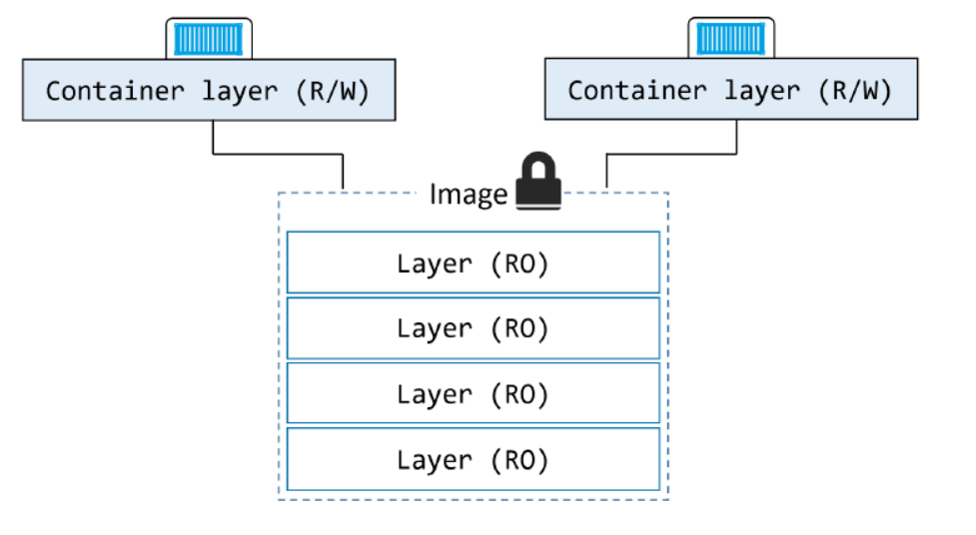
Containers and non-persistent data
Containers are designed to be immutable. It’s a best practice not to change the configuration of a container after it’s deployed. You shouldn’t log into a running container and make configuration changes.
Source: Docker Deep Dive, Nigel Poulton

Slide 45
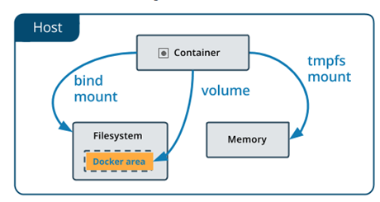
Choose the right type of mount
Volumes are stored in a part of the host filesystem which is managed by Docker.
Non-Docker processes should not modify this part of the filesystem.
Volumes are the best way to persist data in Docker.
Bind mounts may be stored anywhere on the host system.
They may even be important system files or directories.
Non-Docker processes on the Docker host or a Docker container can modify them at any time.
tmpfs mounts are stored in the host system’s memory only, and are never written to the host system’s filesystem.
Source: https://docs.docker.com/storage/

Slide 46
Docker Networking

Slide 47
Docker networking overview
You can connect Docker containers together, or connect them to non-Docker workloads and VLANs.
Docker abstracts the underlying host-attached network from containers.
Docker also treats networks as first-class entities.
By default, Docker includes three networks, and each is provided by a different driver:
The network named bridge is the default network and provided by a bridge driver.
The host network is provided by the host driver, which instructs Docker not to create any special networking namespace or resources for attached containers.
The none network uses the null driver.

Slide 48
Network drivers
bridge: The default network driver. If you don’t specify a driver, this is the type of network you are creating.
host: For standalone containers, remove network isolation between the container and the Docker host, and use the host’s networking directly.
overlay: Overlay networks connect multiple Docker daemons together and enable swarm services to communicate with each other.
ipvlan: IPvlan networks give users total control over both IPv4 and IPv6 addressing.
macvlan: Macvlan networks allow you to assign a MAC address to a container, making it appear as a physical device on your network.
none: For this container, disable all networking.
Network plugins: You can install and use third-party network plugins with Docker.

Slide 49
Bridge networks
A bridge network uses a software bridge which allows containers connected to the same bridge network to communicate, while providing isolation from containers which are not connected to that bridge network.
Bridge networks apply to containers running on the same Docker daemon host.
The default bridge network:
If you don’t not specified any --network flags, the containers connect to the default bridge network.
The default bridge network is not recommended for production.
User-defined bridge networks:
Containers connected to the same user-defined bridge network effectively expose all ports to each other.
User-defined bridges provide automatic DNS resolution between containers.
User-defined bridges provide better isolation.

Slide 50
Host network/Overlay networks
In host network mode the container’s network stack is not isolated from the Docker host.
The container does not get its own IP-address allocated.
Can be useful to optimize performance, and in situations where a container needs to handle a large range of ports
Overlay networks:
Overlay networks are multi-host.
They allow a single network to span multiple hosts so that containers on different hosts can communicate directly.

Slide 51
Building Images

Slide 52
Containerizing an app - overview
The process of containerizing an app looks like this:
Start with your application code and dependencies
Create a Dockerfile that describes your app, its dependencies, and how to run it
Feed the Dockerfile into the docker image build command
Push the new image to a registry (optional)
Run container from the image
You can create a Docker image by either modifying an existing image inside a container or defining and executing a build script called a Dockerfile.

Slide 53
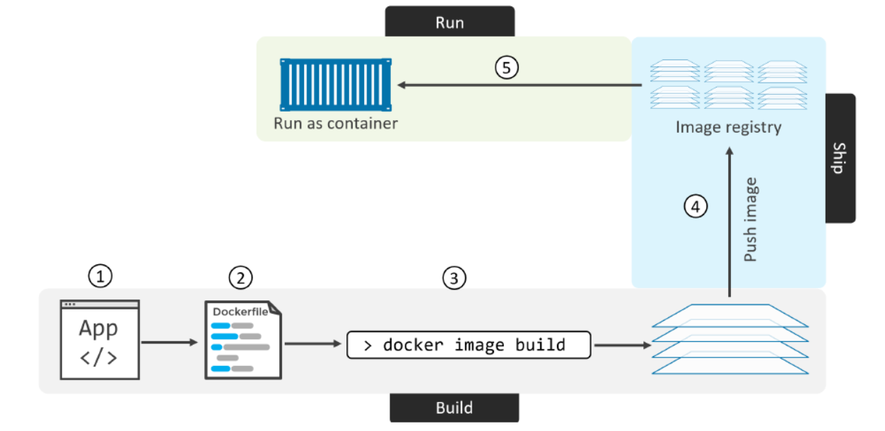

Slide 54
Sharing Docker Images

Slide 55
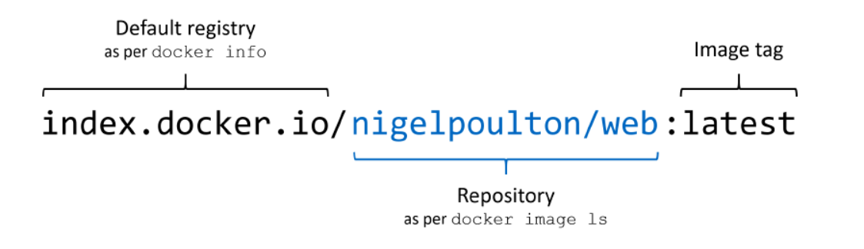
Working with registries, repositories, and image tags
Sharing is all about taking the images you’ve built on your local machine and making them available for other people to use.
The server that stores images centrally is called a Docker registry.
Docker Hub:
the most popular image registry
public registry you can use for free
the default registry for the Docker Engine

Slide 56
Create a repo on Docker Hub
Create a Docker ID for free if you don’t have one.
Docker offers private repositories which allows you to restrict content to specific users or teams. There is one private repository for free per user.
Pushing your own images to Docker Hub
Run the image on a new instance
Introducing self-hosted registries
Docker Registry 2.0
GitLab Container Registry
Harbor Container Registry
Sonatype Nexus Repository OSS
Project Quay

Slide 57
Running Multi-container Apps With Docker Compose

Slide 58
Overview of Docker Compose and installation
Compose is a tool for defining and running multi-container Docker applications in single-engine mode.
Compose command compatibility with docker-compose
Main features of Compose:
Multiple isolated environments on a single host
Preserve volume data when containers are create
Only recreate containers that have changed
Variables and moving a composition between environments
Portability
The Docker Compose file describes the desired state of your app - what it should look like when everything’s running.

Slide 59
Docker Reliability And Health Checks

Slide 60
Self-healing containers with restart policies
Docker monitors the health of your app at a basic level every time you run a container.
Docker checks that the process is still running, and if it stops, the container goes into the exited state.
It’s often a good idea to run containers with a restart policy.
Restart policies are applied per-container
The following restart policies exist:
no: Do not automatically restart the container. (the default)
on-failure: Restart the container if it exits due to an error, which manifests as a non-zero exit code.
always: Always restart the container if it stops. If it is manually stopped, it is restarted only when Docker daemon restarts or the container itself is manually restarted.
unless-stopped: Similar to always, except that when the container is stopped (manually or otherwise), it is not restarted even after Docker daemon restarts.

Slide 61
Building health checks into Docker images
In production you’ll run your apps in a container platform like Docker Swarm or Kubernetes, and those platforms have features that help you deploy self-healing apps.
You can package your containers with information the platform uses to check if the application inside the container is healthy.
The health check is an ongoing test that helps the container platform keep your application running.
Why doesn’t Docker restart or replace an unhealthy container?
Docker can’t safely do that, because the Docker Engine is running on a single server.
Health checks become really useful in a cluster with multiple servers running Docker being managed by Docker Swarm or Kubernetes.

Slide 62
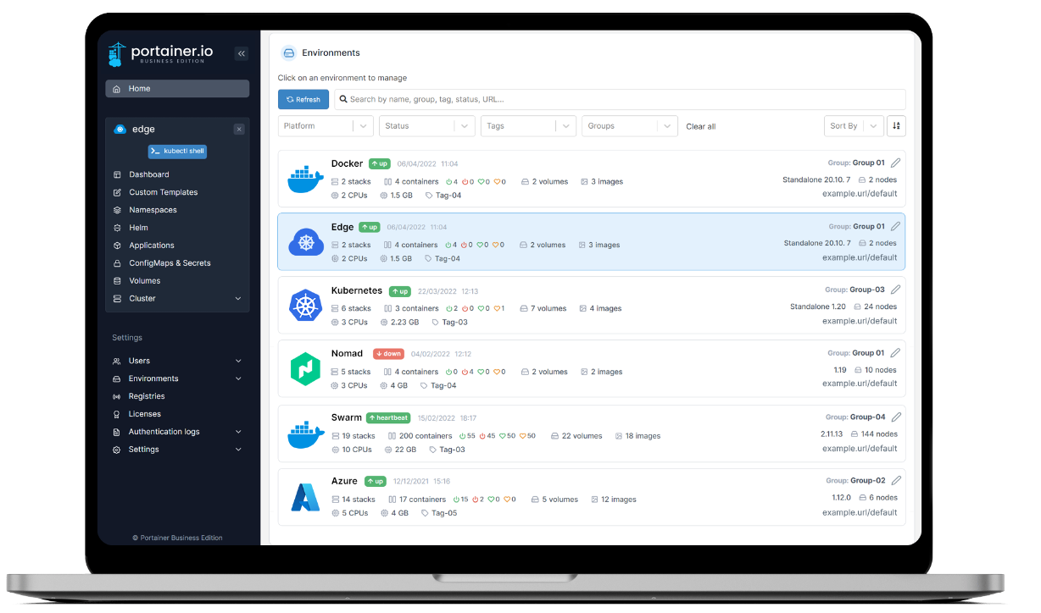
Portainer
Deploy, configure, troubleshoot and secure containers in minutes on Kubernetes, Docker, Swarm and Nomad in any cloud, data center or device.
https://docs.portainer.io/start/install/server/docker/linux

Slide 63
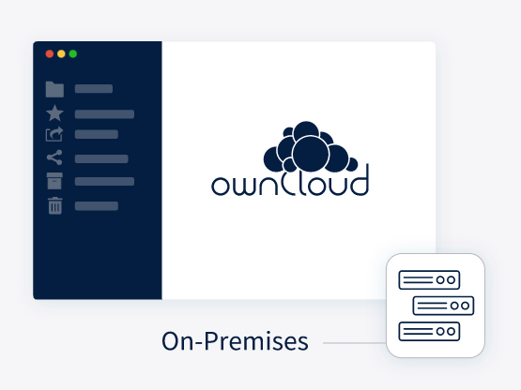

Example: Deploying ownCloud
ownCloud can be installed using the official ownCloud Docker image. This official image works standalone for a quick evaluation but is designed to be used in a docker-compose setup.
https://doc.owncloud.com/server/10.11/admin_manual/installation/docker/

Slide 64
Dodatni viri
The Docker Official Documentation
Awesome Compose
Language-specific guides
Getting Started with Docker
Docker Developer Tools
Docker Extensions
DOCKER COMMUNITY FORUMS

Slide 65
Container orchestration and microservices

Slide 66
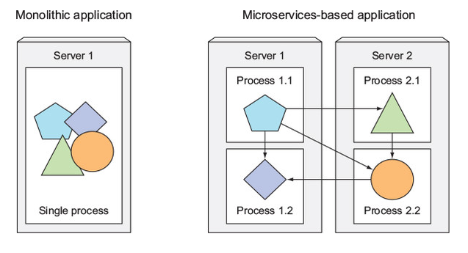
Splitting apps into microservices
We start splitting complex monolithic applications into smaller independently deployable components called microservices.
Each microservice:
runs as an independent process,
communicates with other microservices through simple, well-defined interfaces (APIs)
can be written in the language that’s most appropriate for implementing that specific microservice
Source: Marko Luksa - Kubernetes in Action-Manning Publications (2018)

Slide 67
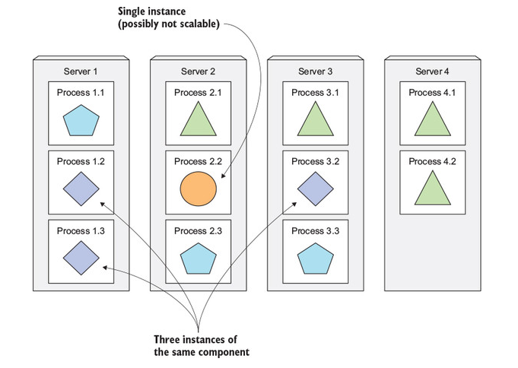
Scaling microservices
Scaling is done on a per-service basis.
you have the option of scaling only those services that require more resources
Splitting the app into microservices allows you to horizontally scale the parts that allow scaling out
Source: Marko Luksa - Kubernetes in Action-Manning Publications (2018)

Slide 68
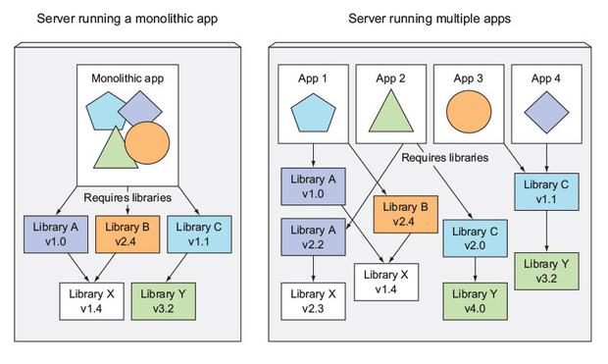
Microservices environment requirements
Components in a microservices architecture are also developed independently
common to have separate teams developing each component
different libraries and different versions of the same libraries
exact same environment during development, testing and in production -> container technologies
Source: Marko Luksa - Kubernetes in Action-Manning Publications (2018)

Slide 69
Automating the management of microservices:
Each microservice is now a separate application with its own development and release cycle.
Individual parts of the entire application no longer need to run on the same computer. -> easier to scale the entire system
Bridging the dev and ops divide:
The development team is now much more involved in the daily management of the deployed software.
Standardizing the cloud:
Customers can now deploy applications to any cloud provider through a standard set of APIs provided by Kubernetes.

Slide 70
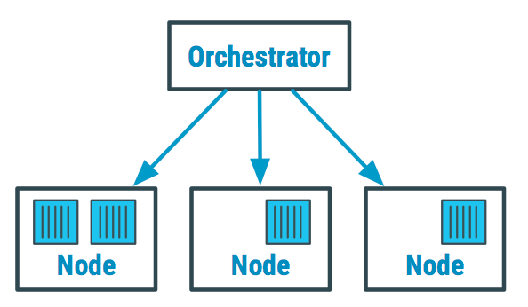
Container Orchestration
Container orchestration is the process of deploying containers on a compute cluster consisting of multiple nodes.
By abstracting the host infrastructure, container orchestration tools allow the users deploying to entire cluster as a single deployment target.
Source: https://devopedia.org/container-orchestration

Slide 71
Container Orchestration envisions a number of features, some of which are mentioned below:
Provisioning hosts
Instantiating a set of containers
Rescheduling failed containers
Linking containers together through agreed interfaces
Exposing services to machines outside of the cluster
Scaling out or down the cluster by adding or removing containers
Docker Swarm vs. Kubernetes

Slide 72
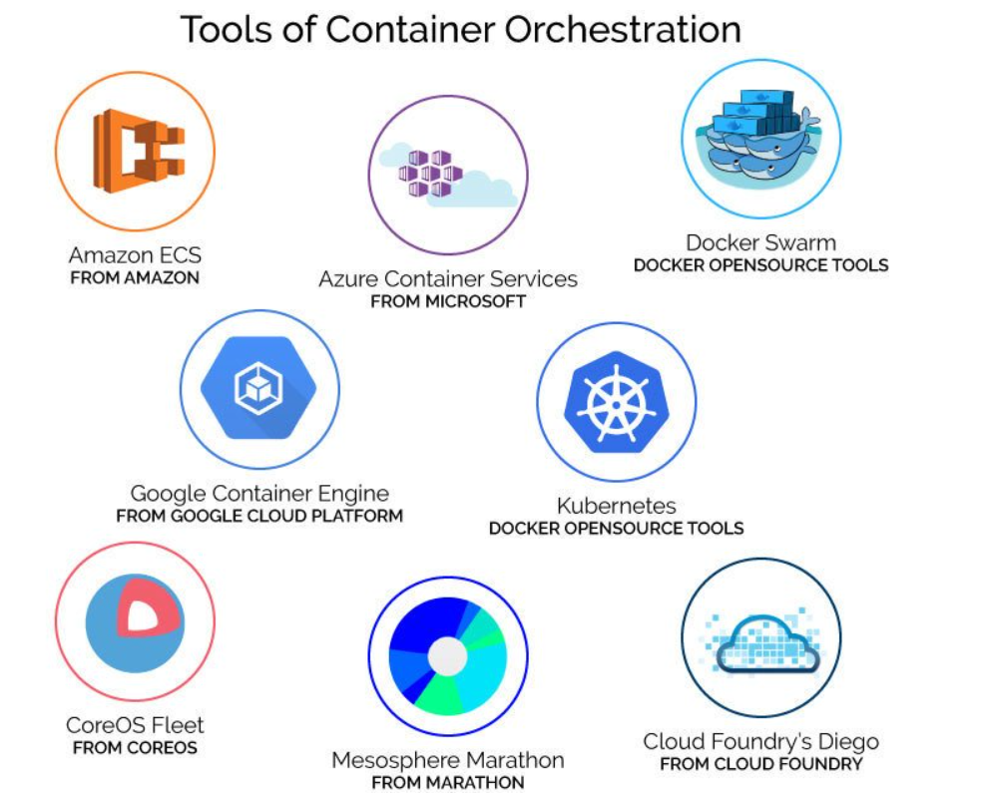

Slide 73
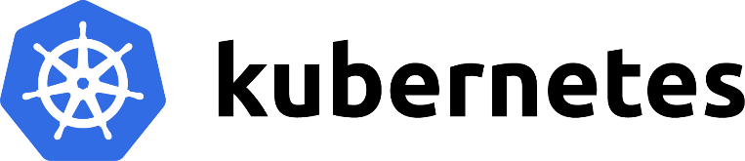
Introduction to Kubernetes

Slide 74

About Kubernetes
https://kubernetes.io/
Rapidly growing ecosystem
The word Kubernetes is Greek for pilot or helmsman, the person who steers the ship
Kubernetes steers your applications and reports on their status while you - the captain - decide where you want the system to go.
HOW TO PRONOUNCE KUBERNETES AND WHAT IS K8S?
Most often it’s Koo-ber-netties or Koo-ber-nay’-tace, but you may also hear Koo-ber-nets, although rarely.
It’s also referred to as Kube or K8s, pronounced Kates, where the 8 signifies the number of letters omitted between the first and last letter.

Slide 75
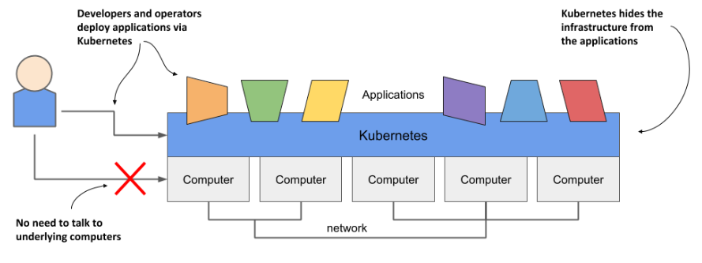
Kubernetes is a software system for automating the deployment and management of complex, large-scale application systems composed of computer processes running in containers.
Main Kubernetes features:
Abstracting away the infrastructure

Slide 76
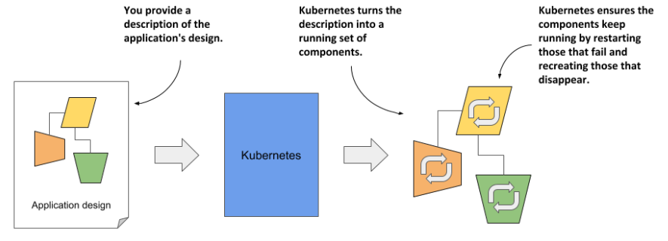
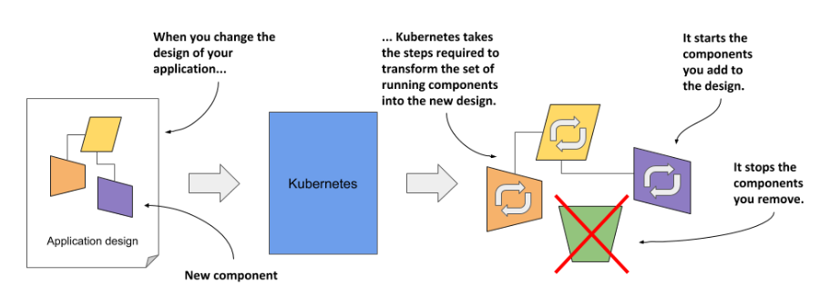
Standardizing how we deploy applications
Deploying applications declaratively

Slide 77
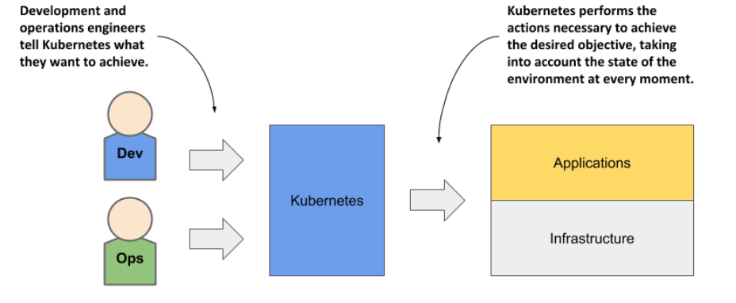
Taking on the daily management of applications

Slide 78

Kubernetes history
Kubernetes was originally developed by Google.
As early as 2014, it was reported that Google start two billion containers every week. That’s over 3,000 containers per second
They run around 2.5 million servers (July 2016, Gartner).
Borg and Omega - the predecessors of Kubernetes
Google developed an internal system called Borg (and later a new system called Omega) that helped both application developers and operators manage these thousands of applications
In 2014 Google introduced Kubernetes, an open-source project.
Under the umbrella of the Cloud Native Computing Foundation (CNCF), which is part of the Linux Foundation.
CNCF organizes several KubeCon - CloudNativeCon conferences per year

Slide 79
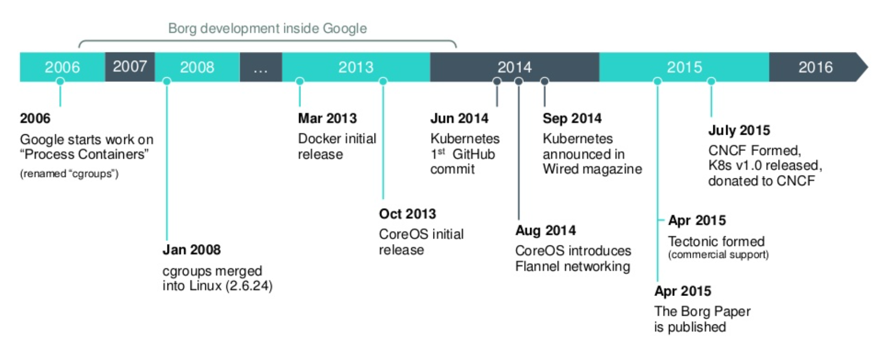
Source: https://www.slideshare.net/egg9/kubernetes-introduction

Slide 80
Understanding Kubernetes
Kubernetes is a platform for running containers.
It takes care of:
starting your containerized applications,
rolling out updates,
maintaining service levels,
scaling to meet demand,
securing access, and much more.

Slide 81

Kubernetes is like an operating system for computer clusters
Infrastructure-related mechanism provided by Kubernetes:
service discovery
horizontal scaling
load-balancing
self-healing
leader election

Slide 82

How Kubernetes fits into a computer cluster?
master nodes -> run the Kubernetes Control Plane
worker nodes -> represent the Workload Plane
Non-production clusters can use a single master node, but highly available clusters use at least three physical master nodes to host the Control Plane. The number of worker nodes depends on the number of applications you’ll deploy.

Slide 83

How all cluster nodes become one large deployment area?
After Kubernetes is installed on the computers, you no longer need to think about individual computers when deploying applications.
You deploy your applications using the Kubernetes API, which is provided by the Kubernetes Control Plane.
Each application must be small enough to fit on one of the worker nodes.

Slide 84

The benefits of using Kubernetes
Self-service deployment of applications
Reducing costs via better infrastructure utilization
Automatically adjusting to changing load
Keeping applications running smoothly (Health checking and self-healing)
Simplifying application development

Slide 85

Kubernetes architecture
A Kubernetes cluster consists of nodes divided into two groups:
A set of master nodes that host the Control Plane components, which are the brains of the system, since they control the entire cluster.
A set of worker nodes that form the Workload Plane, which is where your workloads (or applications) run.

Slide 86
Control Plane components
It consists of several components that run on a single master node or are replicated across multiple master nodes to ensure high availability:
Kubernetes API Server exposes the RESTful Kubernetes API. Engineers using the cluster and other Kubernetes components create objects via this API.
The etcd distributed datastore persists the objects you create through the API, since the API Server itself is stateless.
The Scheduler decides on which worker node each application instance should run.
Controllers bring to life the objects you create through the API.

Slide 87


Slide 88
API server (kube-apiserver)
a control plane component that exposes the Kubernetes API
API server is the front end for the Kubernetes control plane
kube-apiserver is designed to scale horizontally (run several instances of kube-apiserver and balance traffic between those instances)
Kubernetes system components communicate only with the API server
used by all other components and by clients
it provides a CRUD (Create, Read, Update, Delete) interface for querying and modifying the cluster state over a RESTful API
performs validation of those objects, so clients can’t store improperly configured objects

Slide 89

One of the API server’s clients is the command-line tool kubectl
creating a resource from a JSON file and make an HTTP POST request
authenticate the client sending the request (determines who is sending the request)
authorize whether the authenticated user can perform the requested action on the requested resource
validating and/or modifying the resource in the request with admission control plugins
API server then validates the object
Vir: Marko Luksa - Kubernetes in Action-Manning Publications (2018)

Slide 90

etcd
consistent and highly-available key value store used as Kubernetes' backing store for all cluster data
you can run more than one etcd instance to provide both high availability
the number of etcd instances should be an odd number
the only component that talks to etcd directly is the Kubernetes API server
a more robust optimistic locking system
Validation
much simpler to replace it in the future
is the only place Kubernetes stores cluster state and metadata
Notes:
The only component that talks to etcd directly is the Kubernetes API server. All other components read and write data to etcd indirectly through the API server. This brings a few benefits, among them a more robust optimistic locking system as well as validation; and, by abstracting away the actual storage mechanism from all the other components, it’s much simpler to replace it in the future.

Slide 91
Scheduler (kube-scheduler)
watches for newly created Pods with no assigned node, and selects a node for them to run on
the Scheduler doesn’t instruct the selected node -> update the pod definition through the API server -> API server then notifies the Kubelet
you can write your own scheduling component and use that instead
Factors taken into account for scheduling decisions include:
individual and collective resource requirements,
hardware/software/policy constraints,
affinity and anti-affinity specifications,
data locality,
inter-workload interference,
deadlines
Notes:
https://kubernetes.io/docs/concepts/scheduling-eviction/kube-scheduler/
only a single instance of the Scheduler and the Controller Manager may be active at a given time—with the others in standby mode.

Slide 92

The default scheduling algorithm:
Filtering the list of all nodes to obtain a list of acceptable nodes the pod can be scheduled to
Prioritizing the acceptable nodes and choosing the best one.
If multiple nodes have the highest score, round-robin is used to ensure pods are deployed across all of them evenly.
Source: Marko Luksa - Kubernetes in Action-Manning Publications (2018)
Notes:
To determine which nodes are acceptable for the pod, the Scheduler passes each node through a list of configured predicate functions. These check various things such as ○ Can the node fulfill the pod’s requests for hardware resources? You’ll learn how to specify them in chapter 14. ○ Is the node running out of resources (is it reporting a memory or a disk pressure condition)? ○ If the pod requests to be scheduled to a specific node (by name), is this the node? ○ Does the node have a label that matches the node selector in the pod specification (if one is defined)? ○ If the pod requests to be bound to a specific host port (discussed in chapter 13), is that port already taken on this node or not? ○ If the pod requests a certain type of volume, can this volume be mounted for this pod on this node, or is another pod on the node already using the same volume? ○ Does the pod tolerate the taints of the node? Taints and tolerations are explained in chapter 16. ○ Does the pod specify node and/or pod affinity or anti-affinity rules? If yes, would scheduling the pod to this node break those rules? This is also explained in chapter 16

Slide 93
Controller Manager (kube-controller-manager)
Control Plane component that runs controller processes.
Logically, each controller is a separate process, but to reduce complexity, they are all compiled into a single binary and run in a single process.
The list of these controllers includes the:
Replication Manager (a controller for ReplicationController resources)
ReplicaSet, DaemonSet, and Job controllers
Deployment controller
StatefulSet controller
Node controller
Service controller
Endpoints controller
Namespace controller
PersistentVolume controller
Notes:
https://kubernetes.io/docs/concepts/architecture/controller/

Slide 94
there’s a controller for almost every resource you can create
Resources are descriptions of what should be running in the cluster
How ReplicationController works?
They watch the API server for changes to resources
each change that may affect the desired replica count or the number of matched pods
Creates new Pod manifests, posts them to the API server
lets the Scheduler and the Kubelet do their job of scheduling and running the pod
The Replication Manager performs its work by manipulating Pod API objects through the API server. This is how all controllers operate.
They don’t communicate with the Kubelets directly -> they don’t even know Kubelets exist

Slide 95
Worker node components
The worker nodes are the computers on which your applications run.
Each node runs the following set of components:
The Kubelet, an agent that talks to the API server and manages the applications running on its node. It reports the status of these applications and the node via the API.
The Container Runtime, which can be containerd or any other runtime compatible with Kubernetes. It runs your applications in containers as instructed by the Kubelet.
The Kubernetes Service Proxy (Kube Proxy) load-balances network traffic between applications.
Add-on Components
Most Kubernetes clusters also contain several other components. They typically run on the worker nodes but can also be configured to run on the master.
DNS, Web UI (Dashboard), Container Resource Monitoring, Cluster-level Logging, An Ingress controller

Slide 96


Slide 97
Kubelet
An agent that runs on each node in the cluster. It makes sure that containers are running in a Pod.
The kubelet doesn't manage containers which were not created by Kubernetes.
Run pods based on:
pod manifests from the API server
pod manifest files in a specific local directory
This feature is used to run the containerized versions of the Control Plane components as pods

Slide 98
How is kubelet working?
initial job is to register the node it’s running on by creating a Node resource in the API server
continuously monitor the API server for Pods that have been scheduled to the node
start the pod’s containers
It does this by telling the configured container runtime to run a container from a specific container image
constantly monitors running containers
reports their status, events, and resource consumption to the API server
runs the container liveness probes, restarting containers when the probes fail
it terminates containers when their Pod is deleted from the API server and notifies the server that the pod has terminated

Slide 99

Kubernetes Service Proxy (kube-proxy)
kube-proxy is a network proxy that runs on each node in your cluster, implementing part of the Kubernetes Service concept.
Its purpose is to make sure clients can connect to the services you define through the Kubernetes API.
When a service is backed by more than one pod, the proxy performs load balancing across those pods.
kube-proxy maintains network rules on nodes. These network rules allow network communication to your Pods from network sessions inside or outside of your cluster.
kube-proxy uses the operating system packet filtering layer if there is one and it's available. Otherwise, kube-proxy forwards the traffic itself.
Source: Marko Luksa - Kubernetes in Action-Manning Publications (2018)
Notes:
https://betterprogramming.pub/k8s-a-closer-look-at-kube-proxy-372c4e8b090
https://www.tigera.io/blog/comparing-kube-proxy-modes-iptables-or-ipvs/

Slide 100
Container Runtimes
You need to install a container runtime into each node in the cluster so that Pods can run there.
The Open Container Initiative (OCI) has successfully standardized the concept of a container and container image in order to guarantee interoperability between runtimes
Kubernetes has added a Container Runtime Interface (CRI) to allow container runtimes to be pluggable underneath the Kubernetes orchestration layer
Common container runtimes with Kubernetes:
containerd
CRI-O
Docker (deprecated)
Notes:
https://www.infoq.com/articles/container-runtimes-kubernetes/
https://kubernetes.io/docs/setup/production-environment/container-runtimes/
https://kubernetes.io/blog/2016/12/container-runtime-interface-cri-in-kubernetes/

Slide 101

Kubernetes versions
It is always recommended to upgrade the Kubernetes cluster to the latest available stable version.
The Kubernetes project maintains release branches for the most recent three minor releases (1.25, 1.24, 1.23).

Slide 102
Install Kubernetes
If you want to run your applications on Kubernetes, you have to decide whether you want to run them:
Locally
cloud providers
hybrid cloud solution
Running Kubernetes on-premises:
may be your only option if regulations require you to run applications on site
you’ll have to manage Kubernetes yourself
you won’t be able to scale your cluster as easily as when you run it in virtual machines provided by a cloud provider
If you ask anyone in the Kubernetes community if this is a good idea, you’ll usually get a very definite “no”.

Slide 103
Kubernetes brings with it an enormous amount of additional complexity.
The management of production-ready Kubernetes clusters is a multi-billion-dollar industry.
trying out Kubernetes for non-production use-cases is much less problematic
Using a vanilla version of Kubernetes vs Using enterprise-grade Kubernetes distributions
Single node development Kubernetes options:
Docker Desktop: which is a single package that gives you Docker and Kubernetes and all the command-line tools. Docker Desktop is supported on Windows 10 and macOS.
Kind: kind is a tool for running local Kubernetes clusters using Docker container “nodes”.
minikube: minikube is local Kubernetes, focusing on making it easy to learn and develop for Kubernetes.
K3s: Lightweight Kubernetes

Slide 104
Deploying Kubernetes in the cloud:
This has the advantage that you can scale your cluster at any time at short notice if required.
Elasticity of the cluster is certainly one of the main benefits of running Kubernetes in the cloud.
Using Kubernetes is ten times easier than managing it.
Most major cloud providers now offer Kubernetes-as-a-Service.
The top managed Kubernetes offerings include the following:
Google Kubernetes Engine (GKE)
Azure Kubernetes Service (AKS)
Amazon Elastic Kubernetes Service (EKS)
IBM Cloud Kubernetes Service
Red Hat OpenShift Online and Dedicated
VMware Cloud PKS
Alibaba Cloud Container Service for Kubernetes (ACK)

Slide 105

K3s - Lightweight Kubernetes
K3s is a fully compliant Kubernetes distribution with the following enhancements:
Easy to install, half the memory, all in a binary of less than 100 MB.
Packaged as a single binary (all Kubernetes control plane components is encapsulated in a single binary and process).
Lightweight storage backend.
Wrapped in simple launcher that handles a lot of the complexity of TLS and options.
Secure by default with reasonable defaults for lightweight environments.
Added powerful features: a local storage provider, a service load balancer, a Helm controller, and the Traefik ingress controller.
K3s trims the Kubernetes codebase, and the name indicates that it’s half the size of K8s.

Slide 106



Usage
Edge
IoT
CI
Development
ARM
Embedding K8s
Learning
Notes:
https://sum-tech.de/wp-content/uploads/2020/03/photo_2020-03-06_15-39-40-225x300.jpg
https://media.kasperskycontenthub.com/wp-content/uploads/sites/43/2018/09/18085355/abstract-iot-1000x600.jpg
https://forum.huawei.com/enterprise/en/data/attachment/forum/202104/30/020806ifrefr5ez7rnvrjx.png?edge%203%20ieee.png

Slide 107

Architecture
Vir: https://k3s.io/images/how-it-works-k3s.svg

Slide 108
K3s Installation
K3s provides an installation script that is a convenient way to install it as a service on systemd or openrc based systems. This script is available at https://get.k3s.io.
The K3s service will be configured to automatically restart after node reboots or if the process crashes or is killed
Additional utilities will be installed, including kubectl, crictl, ctr, k3s-killall.sh, and k3s-uninstall.sh
A kubeconfig file will be written to /etc/rancher/k3s/k3s.yaml and the kubectl installed by K3s will automatically use it
Notes:
https://rancher.com/docs/k3s/latest/en/quick-start/

Slide 109
Should you even use Kubernetes?
Do your workloads require automated management?
Can you afford to invest your engineers’ time into learning Kubernetes?
Are you prepared for increased costs in the interim?
Don’t believe the hype

Slide 110

How Kubernetes runs an application

Slide 111

Deploying your first application
To interact with Kubernetes, you use a command-line tool called kubectl, pronounced kube-control, kube-C-T-L or kube-cuddle.
Usually, to deploy an application, you’d prepare a JSON or YAML file describing all the components that your application consists of and apply that file to your cluster -> declarative approach

Slide 112

The interaction with Kubernetes consists mainly of the creation and manipulation of objects via its API.

Slide 113

To make the pod accessible externally, you’ll expose it by creating a Service object.

Slide 114

One of the major benefits of running applications in containers is the ease with which you can scale your application deployments.

Slide 115
Kubernetes Pods

Slide 116

Pods
Pod is a co-located group of containers and represents the basic building block in Kubernetes.
You always deploy and operate on a pod of containers.
it’s common for pods to contain only a single container
When a pod does contain multiple containers, all of them are always run on a single worker node
Vir: Marko Luksa - Kubernetes in Action-Manning Publications (2018)

Slide 117
Containers are designed to run only a single process per container
You need to run each process in its own container. That’s how Docker and Kubernetes are meant to be used.
A pod of containers allows you to run closely related processes together and provide them with (almost) the same environment as if they were all running in a single container, while keeping them somewhat isolated
they all share the same hostname and network interfaces
Can run under the same IPC namespace
the file system of each container is fully isolated from other containers

Slide 118


Containers in a pod share the same IP address and port space
processes running in containers of the same can’t bind to the same port numbers
Container can communicate with other containers in the same pod through localhost
All pods in a Kubernetes cluster reside in a single flat, shared, network-address space.
Vir: Marko Luksa - Kubernetes in Action-Manning Publications (2018)

Slide 119
Organizing containers across pods
run only one application in each pod
pods have almost no resource overhead
Example: simple system composed of a front-end web server and a back-end database
you shouldn’t run them in the same pod
they can easily communicate over the network
improving the utilization of your hardware
horizontal scaling (basic unit of scaling) –> Kubernetes doesn’t replicate containers within a pod. It replicates the entire pod
different components have different scaling requirements
Relational databases, usually can’t be scaled
Decide when to place containers in a single pod:
Do these containers have to run on the same host? yes
Do I want to manage them as a single unit? yes
Do they form a unified whole instead of being independent components? yes
Do they have to be scaled together? yes
Can a single node meet their combined resource needs? yes

Slide 120

Vir: Marko Luksa - Kubernetes in Action-Manning Publications (2018)

Slide 121


Sidecar containers
multiple containers into a single pod -> when the application consists of one main process and one or more complementary processes
sidecar containers include log rotators and collectors, data processors, communication adapters, and others
Vir: Marko Luksa - Kubernetes in Action-Manning Publications (2018)
Notes:
Vedno strmimo k temu, da kontejnerje zaženemo v ločenih podih.

Slide 122

V splošnem strokov nikoli ne kreiramo neposredno.
Vir: Marko Luksa - Kubernetes in Action-Manning Publications (2018)
Notes:
Kreiramo jih z uporabo namestitvenih enot tipa namestitev (Deployment), ki doprinesejo:
•zmožnost samodejne vzpostavitve ob izpadu stroka,
•upravljanje replik in
•“rollout” namestitve in posodobitve.

Slide 123

Primer: namestitev stroka
Namestitev
kubectl apply -f kubia-manual.yaml
Pridobitev informaciji o strokih
kubectl get pod kubia-manual -o yaml
kubectl get pods
Pridobitev dnevnikov (logiranja)
kubectl logs kubia-manual
Pošiljanje zahtevkov na strok
Vir: Marko Luksa - Kubernetes in Action-Manning Publications (2018)

Slide 124

Labels (označbe)
Omogočajo organizacijo Kubernetes objektov
Poljuben par ključ-vrednost
Omogočajo izbiranje gostitelja za namestitev
Vir: Marko Luksa - Kubernetes in Action-Manning Publications (2018)
Notes:
For example, with microservices architectures, the number of deployed microservices
can easily exceed 20 or more. Those components will probably be replicated
(multiple copies of the same component will be deployed) and multiple versions or
releases (stable, beta, canary, and so on) will run concurrently. This can lead to hundreds
of pods in the system. Without a mechanism for organizing them, you end up
with a big, incomprehensible mess, such as the one shown in figure 3.6. The figure
shows pods of multiple microservices, with several running multiple replicas, and others
running different releases of the same microservice.

Slide 125

Vir: Marko Luksa - Kubernetes in Action-Manning Publications (2018)

Slide 126
Ustavitev in odstranjevanje strokov
Odstranjevanje stroka po imenu:
kubectl delete pod <POD_NAMES>
Odstranjevanje s pomočjo oznake Label
kubectl delete pod <POD_NAMES> -l <KEY:VALUE>
Odstranitev vseh virov (razen objekta Secret)
kubectl delete all –all

Slide 127
Zdravje strokov
Strokov v praksi ne uporabljamo direktno -> uporabimo drugačne tipe virov (ReplicationControllers, Deployments)
Stroki niso odporni na:
napake v času razporejanja (scheduling)
izpad gostitelja,
In drugih napak zaradi vzdrževanja ali pomanjkanja virov.
V primeru da kontejner v stroku odpove, ga Kubelet ponovno zažene
Nekatere aplikacije nehajo delovati, brez da bi se proces zaustavil (memory leak, infinite loop, deadlock)
Moramo preveriti zdravje od zunaj

Slide 128
Liveness probes
Omogočajo preverjanje ali je kontejner še živ
Lahko jo definiramo za vsak kontejner posebej
Kubernetes periodično preverja stanje in ponovno zažene kontejner v primeru, da Liveness Probe ne zazna delovanja aplikacije
Obstajajo tudi Rediness probe (več o tem kasneje)
Omogočajo tri mehanizme zaznavanja:
HTTP GET probe
TCP Socket probe
Exec probe
V produkcijskih okoljih je praksa vedno definirati Liveness probe
Izpostavimo URL path /health -> preverimo notranji status vitalnih komponent aplikacije ob klicu
Potrebujemo mehanizem, ki poskrbi za zagon vseh strokov ob odpovedi gostitelja

Slide 129
ReplicationControllers (replikacijski nadzornik)
https://kubernetes.io/docs/concepts/workloads/controllers/replicationcontroller/
Replikacijski nadzornik (Replication Controller) zagotovi, da v nekem trenutku teče zahtevano število replik nekega stroka.
Če je strokov preveč, replikacijski nadzornik poskrbi za odstranitev odvečnih, če jih je premalo, poskrbi za zagon preostalih.
Stroki, ki jih ustvari replikacijski nadzornik, so samodejno nadomeščeni v primeru:
izpada zaradi napake pri delovanju,
da je strok pobrisan ali
je bil ustavljen.

Slide 130

Vir: Marko Luksa - Kubernetes in Action-Manning Publications (2018)

Slide 131

Constantly monitors the list of running pods and makes sure the actual number of pods of a “type” always matches the desired number
If too few such pods are running, it creates new replicas from a pod template.
If too few such pods are running, it creates new replicas from a pod template.
Vir: Marko Luksa - Kubernetes in Action-Manning Publications (2018)

Slide 132
Replica Set (replikacijski niz)
Replikacijski niz (RS) nadomešča replikacijski nadzornik (RC).
Večinoma jih ne kreiramo direktno, ampak z uporabo Deployment vira
https://kubernetes.io/docs/concepts/workloads/controllers/replicaset/
Replikacijski niz uporabimo v primeru:
ko imamo zahtevo, da v določenem trenutku teče določeno število podov,
ni potrebe po posodobitvah.
Razlika med RS in RC zajema
podporo za selector
RS podpira selector na osnovi set ov.
RC podpira selector le na osnovi enakosti
podporo za rolling update
V primeru potrebe je priporočena uporaba namestitvene enote tipa namestitev, ki za razliko od RS omogoča deklarativno nadgradnjo

Slide 133


DaemonSets
Run on each and every node in the cluster exactly one instance of the pod
Infrastructure-related pods that perform system-level operations (log collector, resource monitor…)
Source: Marko Luksa - Kubernetes in Action-Manning Publications (2018)
Notes:
Outside of Kubernetes, such processes would usually be started through system init scripts or the systemd daemon during node boot up.
If a node goes down, the DaemonSet doesn’t cause the pod to be created elsewhere.
But when a new node is added to the cluster, the DaemonSet immediately deploys a new pod instance to it.
A DaemonSet deploys pods to all nodes in the cluster, unless you specify that the pods should only run on a subset of all the nodes.

Slide 134

Primer: DaemonSet – SSD monitor
Želimo namestiti aplikacijo, ki monitorira SSD na vse tiste gostitelje, ki podpirajo SSD
Vir: Marko Luksa - Kubernetes in Action-Manning Publications (2018)

Slide 135

Jobs / CronJob
Allows you to run a pod whose container isn’t restarted when the process running inside finishes successfully.
In the event of a node failure, the pods on that node that are managed by a Job will be rescheduled to other nodes.
Jobs are useful for ad hoc tasks, where it’s crucial that the task finishes properly.
CronJob resource is useful for jobs that need to be run at a specific time in the future or repeatedly in the specified interval.
Source: Marko Luksa - Kubernetes in Action-Manning Publications (2018)

Slide 136
Service
Pods will usually respond to HTTP requests coming either from other pods inside the cluster or from clients outside the cluster.
Specifying the exact IP address or hostname of the server providing the service in the client’s configuration files wouldn’t work in Kubernetes:
Pods are ephemeral
Kubernetes assigns an IP address to a pod after the pod has been scheduled to a node and before it’s started
Horizontal scaling means multiple pods may provide the same service
To solve these problems, Kubernetes provides another resource type - Services
Notes:
https://kubernetes.io/docs/concepts/services-networking/service/

Slide 137

A Kubernetes Service is a resource you create to make a single, constant point of entry to a group of pods providing the same service (ClusterIP).
The IP address and port never change while the service exists.
Connections are routed to one of the pods backing that service.
Source: Marko Luksa - Kubernetes in Action-Manning Publications (2018)

Slide 138

Primer: ustvarjanje storitve
3 ReplicaSet stroki in Service
Vir: Marko Luksa - Kubernetes in Action-Manning Publications (2018)

Slide 139

Vir: Marko Luksa - Kubernetes in Action-Manning Publications (2018)

Slide 140

Primeri povezav:
večim strokom z enako storitvijo dodelimo enoten IP, ki je dosegljiv ostalim strokom znotraj gruče (ClusterIP)
izpostavimo storitve izven gruče preko storitve (externalName)
Izpostavimo storitev zunanjim odjemalcem:
Vir: Marko Luksa - Kubernetes in Action-Manning Publications (2018)

Slide 141
NodePort - Vsak gostitelj v gruči odpre vrata in usmeri zunanji promet iz teh vrat na konfigururano storitev. Storitev je na voljo na vratih vseh gostiteljev.
LoadBalancer - Storitev je dosegljiva preko namenskega load balancer-ja, zagotovljenega s strani ponudnika oblačnih storitev. Ta usmeri promet na vrata vseh gostiteljev v gruči.
Ingress - povsem drugačni mehanizem za izpostavljanje storitev preko enega naslova IP. Deluje na omrežnem nivoju 7 (HTTP) in ponuja več možnosti od ostalih storitev (omrežni nivo 4).

Slide 142

NodePort service
Vir: Marko Luksa - Kubernetes in Action-Manning Publications (2018)

Slide 143

LoadBalancer service
Vir: Marko Luksa - Kubernetes in Action-Manning Publications (2018)

Slide 144

Ingress
Vir: Marko Luksa - Kubernetes in Action-Manning Publications (2018)

Slide 145

Vir: Marko Luksa - Kubernetes in Action-Manning Publications (2018)

Slide 146


Deployment (namestitev)
https://kubernetes.io/docs/concepts/workloads/controllers/deployment/
omogoča deklarativno posodabljanje strokov in replikacijskih nizov
Možnosti posodobitev:
RollingUpdate (ko lahko imamo obe verziji aplikacije zagnane naenkrat)
Recreate (ko dve različni verziji aplikaciji ne morejo biti zagnani vzporedno)
Vir: Marko Luksa - Kubernetes in Action-Manning Publications (2018)

Slide 147

Vir: Marko Luksa - Kubernetes in Action-Manning Publications (2018)

Slide 148

Vir: Marko Luksa - Kubernetes in Action-Manning Publications (2018)

Slide 149
Upravljanje z viri
Brez omejitev lahko strok porabi vse vire, ki so mu na voljo
Specificiramo lahko CPU in pomnilnik za vsak kontejner v stroku
Specifikacija virov vpliva na razporejanje strokov
requests -> minimalna količina virov, ki jih strok potrebuje
limits -> maksimalna poraba virov za posamezen strok
V primeru, da na gostitelju ni dovolj virov glede na zahteve, scheduler ne bo namestil stroka na tega gostitelja

Slide 150


Vir: Marko Luksa - Kubernetes in Action-Manning Publications (2018)

Slide 151
Automatic scaling
Horizontalno vs vertikalno skaliranje
Možno ročno skaliranje preko replicas polja
Ni praktično ker moremo v naprej poznati obremenitev aplikaicje
Kubernetes omogoča avtomatsko skaliranje strokov ko zazna povečano CPU porabo
V oblačni infrastrukturi je možno tudi skaliranje gostiteljev
Horizontal pod autoscaling
skaliranje števila replik stroka
skaliramo lahko glede na CPU, pomnilnik, zahtevki na sekundo
Vertical pod autoscaling
ni še enostavne podpore
Horizontal scaling of cluster nodes
avtomatsko skaliranje števila gostiteljev

Slide 152

Vir: Marko Luksa - Kubernetes in Action-Manning Publications (2018)

Slide 153
Volumes
https://kubernetes.io/docs/concepts/storage/volumes/
Omogočajo kontejnerjem v stroku dostop do zunanjega prostora za shranjevanje podatkov in/ali deljenje prostora za shranjevanje med kontejnerji.
Privzeto si procesi znotraj stroka ne delijo datotečnega sistema.
Datotečni sistem izhaja iz slike kontejnerja.
Vir volumes je del stroka.

Slide 154


Vir: Marko Luksa - Kubernetes in Action-Manning Publications (2018)

Slide 155
Volume types
emptyDir - A simple empty directory used for storing transient data.
hostPath - Used for mounting directories from the worker node’s filesystem into the pod.
gitRepo - A volume initialized by checking out the contents of a Git repository.
nfs - An NFS share mounted into the pod.
gcePersistentDisk (Google Compute Engine Persistent Disk), awsElasticBlockStore (Amazon Web Services Elastic Block Store Volume), azureDisk (Microsoft Azure Disk Volume) - Used for mounting cloud provider-specific storage.
configMap, secret, downwardAPI - Special types of volumes used to expose certain Kubernetes resources and cluster information to the pod.

Slide 156

PersistentVolumes/PersistentVolumeClaims
Vir: Marko Luksa - Kubernetes in Action-Manning Publications (2018)

Slide 157

Vir: Marko Luksa - Kubernetes in Action-Manning Publications (2018)

Slide 158

Dynamic PersistentVolume provisioning
Vir: Marko Luksa - Kubernetes in Action-Manning Publications (2018)

Slide 159

Konfiguracija aplikaciji
Aplikacijo konfigururamo preko:
argumentov v ukazni vrstici
konfiguracijske datoteke
okoljskih spremenljivk
Vir za shranjevanje konfiguracije v Kubernetes-u imenujemo ConfigMap
Za shranjevanje občutljive konfiguracije Kubernetes ponuja vir Secret
Vir: Marko Luksa - Kubernetes in Action-Manning Publications (2018)

Slide 160


ConfigMap
https://kubernetes.io/docs/concepts/configuration/configmap/
Objekt, ki omogoča ločitev konfiguracijskih možnosti
Preslikava par ključ - vrednost
Lahko preslikamo tudi celotne konfiguracijske datoteke
Vir: Marko Luksa - Kubernetes in Action-Manning Publications (2018)

Slide 161
Secret
https://kubernetes.io/docs/concepts/configuration/secret/
Včasih imamo konfiguracijo z občutljivimi podatki, ki jo želimo želimo varno uporabiti
Preslikava par ključ - vrednost
Uporabimo jih na isti način kot ConfigMaps
https://kubernetes.io/docs/concepts/configuration/secret/#risks
A secret is only sent to a node if a Pod on that node requires it. The kubelet stores the secret into a tmpfs so that the secret is not written to disk storage. Once the Pod that depends on the secret is deleted, the kubelet will delete its local copy of the secret data as well.
On most Kubernetes distributions, communication between users and the API server, and from the API server to the kubelets, is protected by SSL/TLS. Secrets are protected when transmitted over these channels.

Slide 162

Vir: Marko Luksa - Kubernetes in Action-Manning Publications (2018)

Slide 163

Jobs / CronJob
https://kubernetes.io/docs/concepts/workloads/controllers/job/
Omogočajo zagon strokov z enim končnim opravilom
Primer: prenos in obdelava končne množice podatkov
Vir: Marko Luksa - Kubernetes in Action-Manning Publications (2018)

Slide 164
Nasveti
Web UI (Dashboard)
Connect a Front End to a Back End Using a Service
Unofficial Kubernetes

Slide 165
Vabljeni k sodelovanju!
info@ltfe.org
+386 1 476 8988
www.ltfe.org

